Slide 1
Threat Modeling AI and Blockchain Applications: Security by Design for Emerging Technologies
June 19°,2 025
Marco M. Morana

Slide 2
Table Of Contents
My Personal Journey With OWASP
Challenges of Applying Security By Design To Emerging Technologies (AI and Blockchain)
Threat Modeling:
The Importance of Architectural Context
Featuring PASTA Attack & Risk Centric Methodology
Application Threat Modeling Examples:
Blockchain Decentralized Application dApp
Secure AI Framework (SAIF) Architecture
Runtime and AI Generated
Key Takeaways and Call for Action

Slide 3
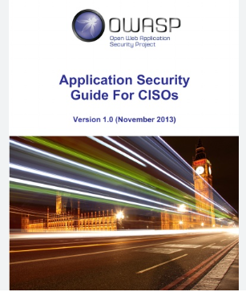




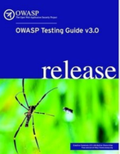
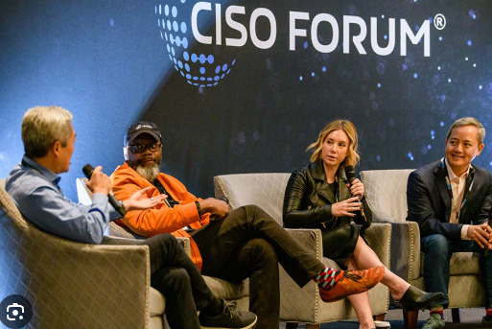

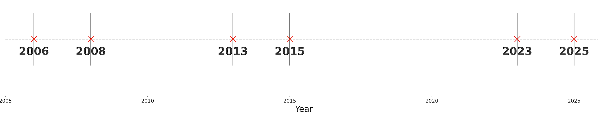
My OWASP Journey
OWASP has shaped how I approach security by design, from legacy web to emerging technologies like blockchain and AI
Notes:
“Threat Modeling with OWASP: A Journey from Testing to Emerging Tech”
“My journey with OWASP goes back almost two decades and it began thanks to Mark Curphey, who was my boss at Foundstone and also the founder of OWASP. Mark encouraged me to contribute to the OWASP Testing Guide, which at the time was led by Matteo Meucci, and to the Secure Coding Guide under Eoin Keary.
That early experience gave me a deep appreciation for community-driven security. I became an OWASP Chapter Lead in 2007, and later, during my time in London from 2011 to 2015, I led the OWASP CISO Guide project and co-authored the Risk-Centric Threat Modeling methodology. That work became foundational to modern OWASP threat modeling, and many of the diagrams from that era are still used today.
Collaborating with Tony UcedaVélez, we published the PASTA methodology in 2015, bridging architectural decomposition with attack simulation and business impact analysis.
When I returned to the U.S. in 2016, I became Head of Security for Emerging Technologies at Citi, working closely with blockchain startups and piloting enterprise use cases. That evolved into a broader leadership role at JPMorgan Chase, where I served as Executive Director and represented the firm at CISO roundtables, industry panels—even television interviews—discussing blockchain security.
That work culminated in a five-year journey that led to my recent book, Blockchain Application Security, focused on designing attack-resilient decentralized applications. While my direct OWASP contributions have slowed, I’ve continued to collaborate with industry leaders, CISOs, and CTOs, carrying the OWASP ethos of secure design into real-world emerging technologies.”

Slide 4

Security By Design of Emerging Technologies
Why It Falls Short:
Rapid Innovation: the technology evolves faster than the corresponding security design patterns
Security as Afterthought: early adoption tends to prioritize functionality over secure design, use cases are rarely tested against real-word threat and attack scenarios
Tooling Gaps: security tools for AI are internally ad-hoc developed (e.g. RAG tools) lagging behind to technology innovations

Slide 5
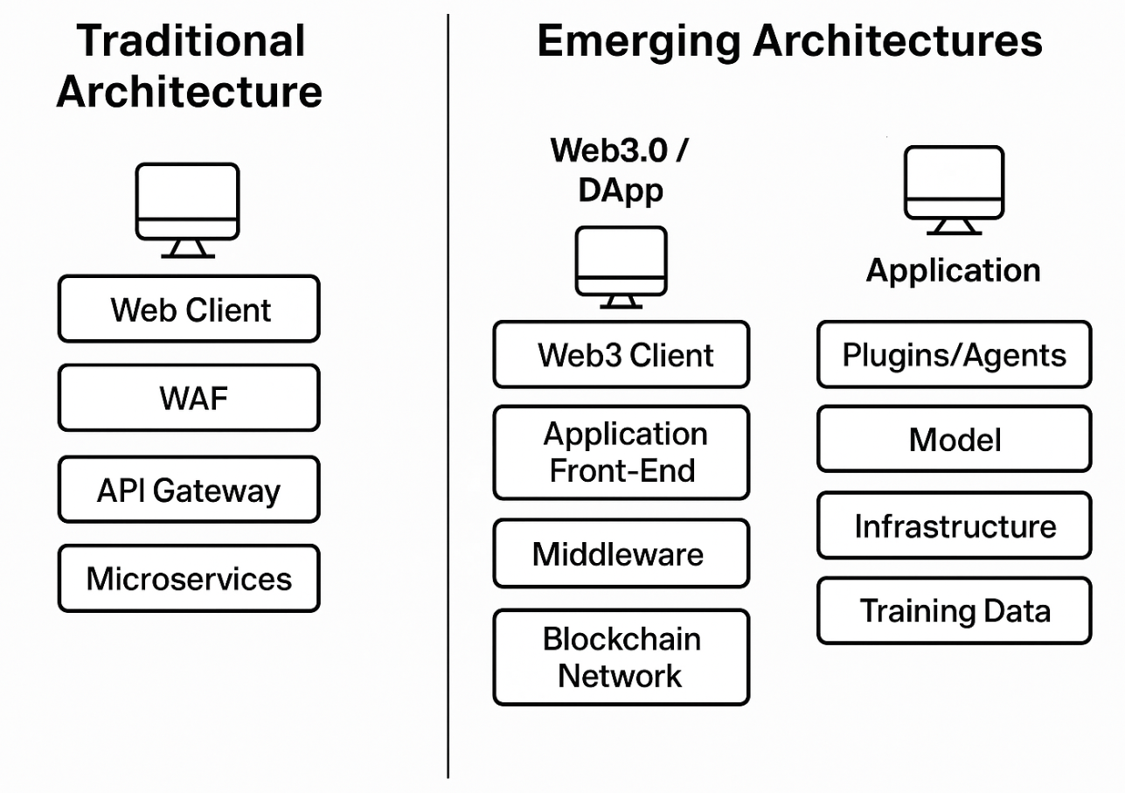
Let’s Start With the Architecture
Know What You’re Securing: Understand the context for components, end to end data flows, and trust boundaries
Analyze The Risks: Threats, Assets, Attack Surface & Vectors, Weaknesses (CWEs), Vulnerabilities (CVEs) and Impacts
Design for Attack Resilience (The Goal): anticipate threats, contain compromises, and maintain critical functionality even when under attacks
Notes:
In traditional threat modeling, the architectural context must accurately reflect the deployed system and its core components within the target environment. For example, in a microservices-based architecture, this includes the implementation of baseline security controls through Infrastructure as Code (IaC), such as Web Application Firewalls (WAFs) and API Gateways. Risk analysis in this scenario often centers around secure container image configurations, API authentication using standards like OAuth 2.0, and enforcing authentication and authorization at the API Gateway, with the WAF providing logging and filtering of potential attacks.
Microservices, typically exposed via APIs, are deployed in software containers within segmented and protected network tiers. In contrast, emerging technologies such as Web 3.0 and decentralized applications (DApps) introduce new architectural paradigms and security considerations—particularly around transactional integrity and value exchange. For example, a financial transaction may originate from a web client, be cryptographically signed on the frontend, and then broadcast to the blockchain for verification and execution. These transactions often support functions such as lending or payments in cryptocurrency. In such cases, security depends heavily on robust key management for signing operations, the integrity of transaction verification, and the secure execution of smart contracts to ensure that events are accurately recorded and validated on-chain. Threats typically target digital wallets, smart contracts, and the supporting mechanisms for identity verification and automated transaction flows.
For AI and LLM-based applications, the architectural stack includes user-facing applications, orchestration plugins or agents, and underlying trained models deployed on specialized infrastructure. A common use case is a chatbot responding to user queries. Security risks in this architecture span several layers: application-layer threats such as prompt injection, model-layer risks including training data poisoning and evasion attacks, and infrastructure-level exposures that impact the model’s availability, confidentiality, or integrity. These risks highlight the need for dynamic threat modeling approaches that adapt to the evolving nature of LLM deployments and their increasingly composable architectures.

Slide 6
PASTA Threat Modeling
Just a reminder PASTA is a threat modeling methodology, not a culinary school. So, if you came here expecting a special family recipe… you’re in the wrong slide deck!” Although, we do serve up a spicy helping of attack simulation and a generous portion of risk analysis… al dente
Forget boiling water—this PASTA serves up:
🔍 Risk Reduction over red sauce – prioritize threats based on business impact
🧠 Attack Insights – with MITRE ATT&CK, kill chains, and a dash of TTPs
🏗️ Architecture Focus – trust zones, data flows, and all the spicy interactions
🕵️‍♂️ Threat Intelligence – real-world actors, IOCs, and techniques—no kitchen spies here
🎯 Context-Aware Threats – tailored to your tech stack, not a one-size-fits-all dish
🧩 Vulnerability Pairings – CVEs, CWEs, and scan results for every bite
🚀 Emerging Tech Ready – works great with LLMs, DApps, smart contracts—mangia secure-by-design!

Slide 7
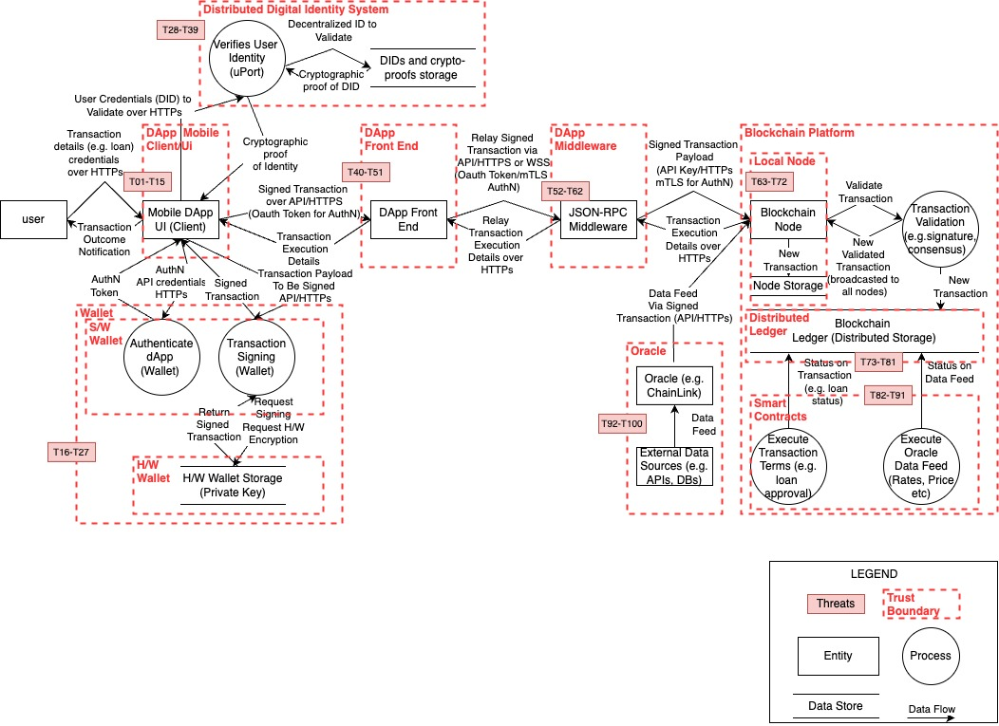
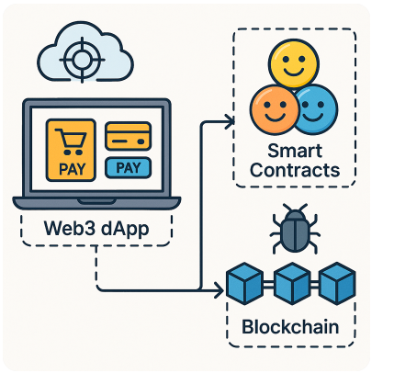
Distributed Application (dApp) Threat Model
Notes:
We’re using a Decentralized Finance (DeFi) DApp for lending and borrowing as our example. The system components—visualized via a Data Flow Diagram (DFD) include:
Smart contracts for loan issuance and collateralization
Digital wallet interfaces for signing transactions
The blockchain ledger and oracle feeds
User and admin frontends
Trust boundaries across users ↔ smart contracts ↔ oracles ↔ blockchain
⚠ Threat Landscape:
As application complexity increases—particularly in mobile interfaces and smart contract orchestration—the threat surface expands exponentially. Even one change can introduce dozens of new attack vectors.
Threat Mapping Challenge: Visualizing over 100 threats in this example, including:
Smart Contracts: Reentrancy, logic flaws, flash loan abuse
Wallets & Keys: Private key leakage, compromised signing
Oracles: Price manipulation, stale data feeds
Governance: Malicious proposals, quorum bypass
🔄 Why Diagrams Aren’t Enough:
PASTA doesn’t stop at drawing data flows—it simulates attack paths and validates defenses.
Real-world breaches (Ronin, Poly Network, bZx) have exposed flaws in:
Wallet architecture
Oracle design
Smart contract logic
PASTA learns from these to generate:
Attack trees (see Slide 6)
Validation plans
Testing scopes for audit and security engineering
🧪 Why This Matters to Builders:
Security-by-design for Web3 means:
Modeling likely attacks
Simulating exploits before they happen
Validating controls in real-world contexts
This is critical for engineering and product teams building blockchain-based applications.
💬 Final Thought:
Modeling threats without simulating them is like drawing a map and never exploring the terrain.
Let me know if you’d like a matching slide or visual for this message.

Slide 8
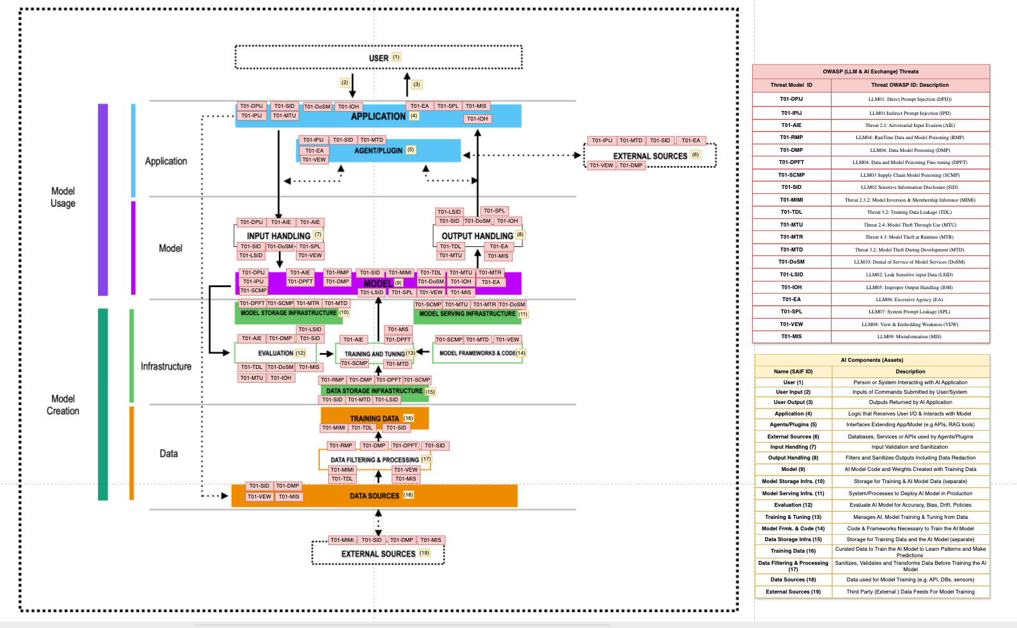
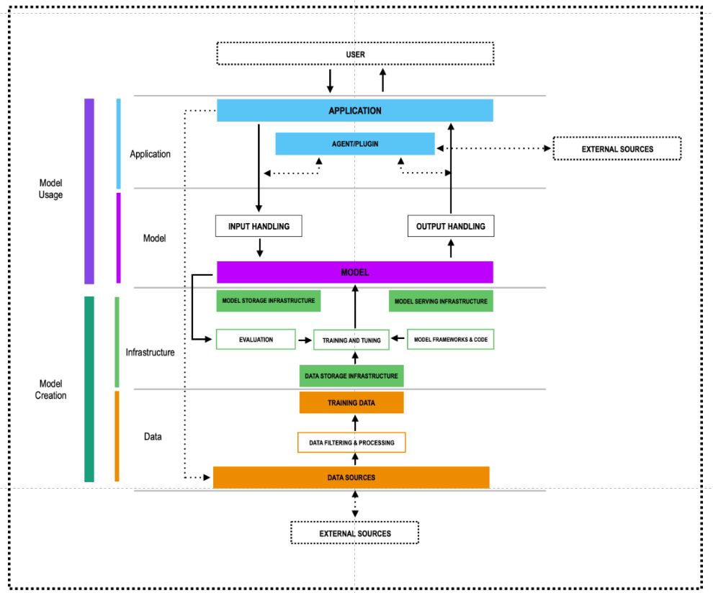
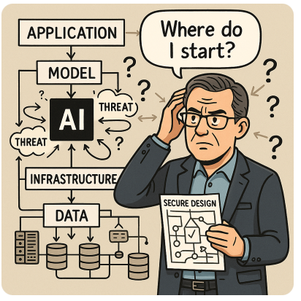
AI Threat Model (High Level Attack Surface)
Notes:
We are taking deliberate steps to create a rulebook—a practical guide for building secure AI systems.
By assembling this framework, we enable anyone contributing to this project to follow a consistent, repeatable model for identifying and mitigating threats. This rulebook helps explain critical aspects such as AI inputs, outputs, and training data—all of which represent key threat surfaces, including data poisoning risks.
📌 Core Message (Subtitle):
SAIF and OWASP LLM Top 10 offer a strategic lens on AI risks—but deeper, layered threat modeling is essential for secure-by-design AI.
🧩 SAIF: A Layered Model for AI Security
Google’s Secure AI Framework (SAIF) defines four layers, each a target for threat modeling:
Application Layer (UIs, APIs, Agents)
Model Layer (Inference Engines, Embeddings)
Infrastructure Layer (Compute, CI/CD, Model Repos)
Data Layer (Training Sources, Pipelines, Filtering)
Threat Examples Mapped to SAIF Components:
🧠 Model Layer:
LLM04: Data & Model Poisoning
AI Exchange: Adversarial Input Evasion
📦 Infrastructure Layer:
LLM03: Supply Chain Tampering
Risks: Model Exfiltration, Unauthorized Model Updates
🗃️ Data Layer:
AI Exchange: Training Data Leakage (TDL)
LLM02: Sensitive Information Disclosure
⚠️ Where High-Level Frameworks Fall Short
SAIF and OWASP provide excellent architectural visibility, but:
They don’t capture real-time, runtime behaviors.
They overlook complex orchestration in LLM agents, plugins, or RAG pipelines.
They lack insight into emerging multi-stage attack paths (e.g., prompt injection → agent misuse → unauthorized API call).
What’s Needed:
Dynamic threat modeling across layers
Simulation of adaptive threat surfaces like vector DBs, plugin behaviors
Chained attack modeling to understand propagation of risk
✅ Takeaway:
High-level frameworks provide essential visibility. But secure-by-design AI requires deeper threat modeling, dynamic interaction analysis, and adversarial testing to ensure real-world security and resilience.

Slide 9
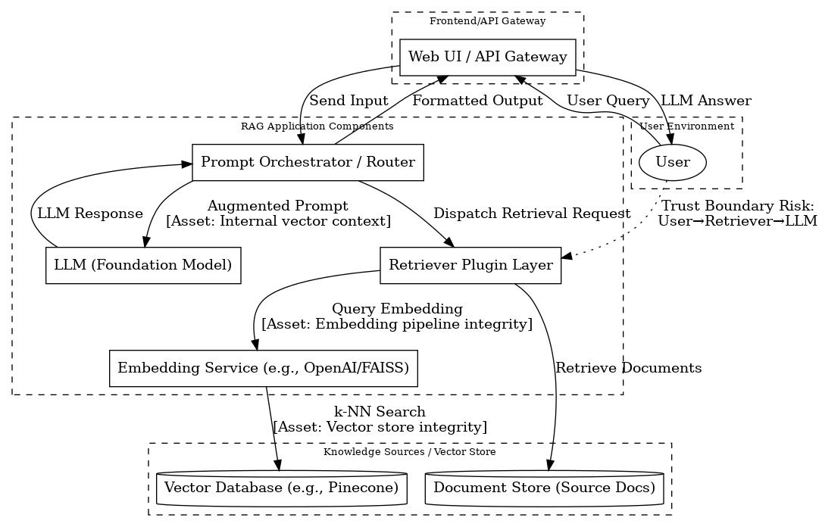
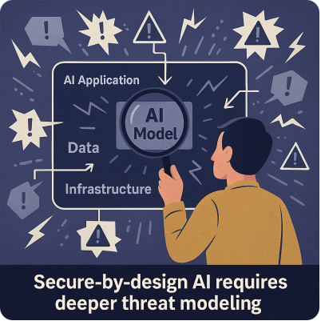
AI Threat Model (Chatbot LLM, Threat LLM08, Detail Level)
Threat ID | Threat Vector | DFD Component | Asset at Risk | Threat Description
T-LLM08-01 | Embedding Injection | Embedding Service | Embedding pipeline integrity | Adversarial inputs crafted to embed malicious semantics
T-LLM08-02 | Vector Poisoning | Vector Database | Vector store integrity | Insertion of poisoned or misleading embeddings to distort retrieval
T-LLM08-03 | Semantic Drift | Retriever Plugin Layer | Trust boundary: User → Retriever → LLM | Inputs cause retrieval of semantically misleading content
T-LLM08-04 | Context Contamination | Prompt Orchestrator / Router | Internal vector context | Malicious context blended into legitimate prompts via retrieved vectors
T-LLM08-05 | Latent Execution | LLM (Foundation Model) | Inference logic | Adversarial embeddings activate under specific inference conditions
T-LLM08-06 | Unauthorized Embedding Access | Vector Database | Embedding access control | Exploitation of weak or missing authorization controls to read/write embeddings
T-LLM08-07 | Vector Source Spoofing | Ingestion Pipeline (Not Shown) | Embedding ingestion integrity | Insertion of embeddings from unauthenticated or spoofed data sources
T-LLM08-08 | Embedding Integrity Bypass | Embedding Service | Embedding verification logic | Insertion of altered or backdoored vectors bypassing integrity validation
T-LLM08-09 | Unsafe Embedding Serialization | Storage & Memory Layer (Not Shown) | Embedding storage safety | Exploitation of deserialization flaws in vector parsing routines
T-LLM08-10 | Response Encoding Flaw | Prompt Router / Application Layer | Embedding output fidelity | Embedding output reused in prompts without proper encoding or filtering
EI
VP
Notes:
Core Message (Subtitle):
PASTA enables deep, attack-centric threat modeling of AI risks like vector poisoning within LLM-powered chatbots.
🧠
Use Case Context:
Application: LLM-based chatbot using retrieval-augmented generation (RAG)
Attack Surface: User inputs → embedded → vector database → re-ranked → injected into model context
🧩
PASTA Walkthrough: LLM08 Applied
Define Objectives
Support secure LLM chatbot interaction with minimal hallucination and no injection.
2. Define Technical Scope
Application (chat UI, orchestrator), Model (LLM), Infrastructure (embedding + vector DB), Data (docs, embeddings).
3. Application Decomposition
DFD identifies trust boundaries across user input, plugin, embedding store, and model inference.
4. Threat Analysis
Focus on embedding manipulation and poisoned vectors inserted by attackers to shift model output.
5. Vulnerability & Weakness Analysis
Mapped to CWE-20 (Improper Input Validation), CWE-94 (Code Injection), exposed in SAIF #7, #10.
6. Attack Simulation
Simulated prompt injection via adversarial vector (e.g., crafted FAQ doc); observed deviation in LLM behavior.
7. Risk & Impact Analysis
Business impact = user misinformation; Technical = output corruption, trust erosion. Use NIST and OWASP risk models.
Why This Matters:
Attack vectors live inside the embeddings—not just the prompt.
Vector poisoning is hard to detect with surface-level validation.
Controls like embedding validation, input sanitization, and context-aware filtering must be tested through adversarial simulations.
💡
Practical Takeaway:
Security by design for LLMs means simulating threats like vector poisoning before they’re exploited—and aligning countermeasures with where the threat manifests.

Slide 10
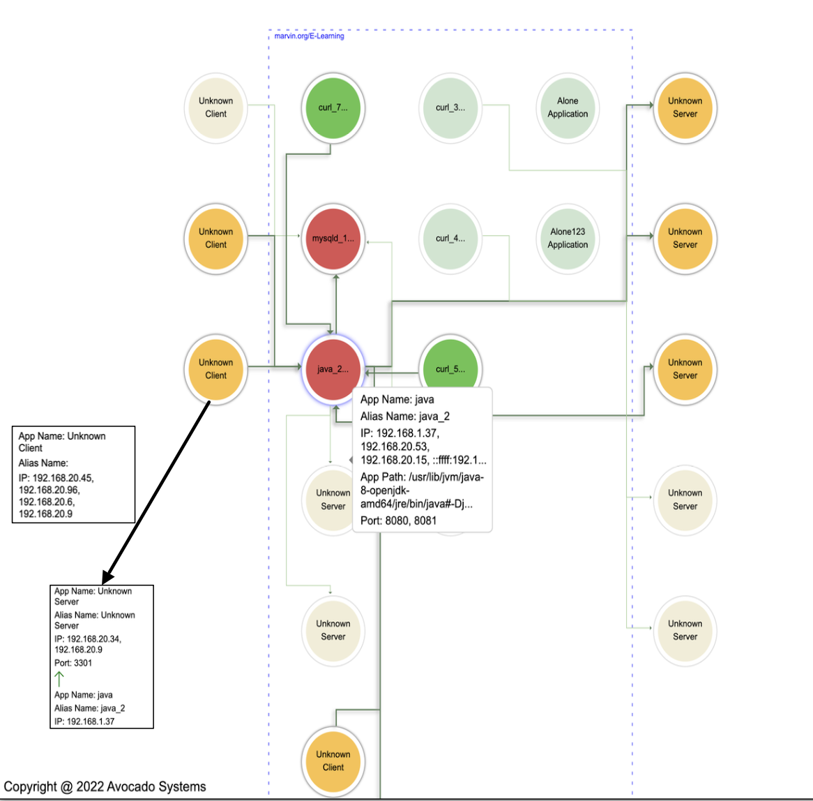
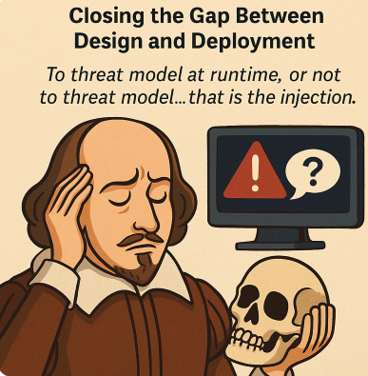
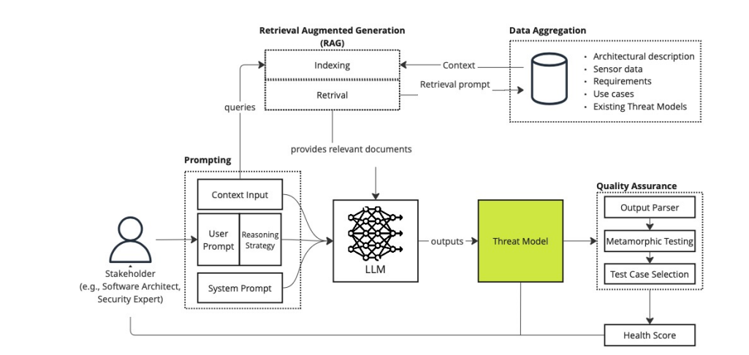
Runtime Threat Modeling & AI Threat Modeling Tools
Feeding Runtime Architectural Context
Into Threat Model Baselines for AI Threat Model Generation to avoid GIGO
(Garbage In-Garbage-Out)
Notes:
– Runtime Threat Modeling: Closing the Gap Between Design and Deployment
🔹
Core Message (Subtitle):
In emerging technologies, real security comes from modeling threats where they live: in runtime.
🧩
Why Runtime Threat Modeling Matters:
Most design-phase threat models become outdated the moment code is deployed.
Runtime environments introduce:
Unmodeled data flows
Dynamic agents, plugins, APIs
Changed architecture not reflected in design documents
Tools like Avocado Systems automate DFD extraction from live deployments, ensuring the threat model is accurate and contextual.
⚠️
The AI Threat Modeling Paradox:
New tools use LLMs to generate threat models based on described or inferred architectures.
The problem?
Garbage in = garbage out
If the LLM misunderstands the architecture, the threat model is fiction
This introduces a false sense of security and real liability risks
🤝
Runtime + AI Threat Modeling: Better Together
Combine:
Runtime DFDs and actual component analysis
With LLM-assisted threat enumeration and control mapping
Result: Threat models that are realistic, testable, and defensible
💬
Closing Thought:
Design-time threat modeling tells you what should be happening. Runtime threat modeling tells you what is happening—don’t secure blindly.

Slide 11


Key Takeaways And Call For Action
Enhancing Security by Design: Adopt a risk-driven, attack-informed, and continuously validated approach to secure emerging technologies.
Attack Centric Threat Modeling: AI and blockchain demand layered, runtime-aware threat modeling that reflects real-world attack surfaces.
Collaborative Security Practice: Initiatives like OWASP AI Exchange, Blockchain Security, and Testing Guides advance through active practitioner contributions.
Let’s build secure design together: Leverage open standards, community frameworks, and real-world threat intelligence.
Get involved with OWASP: Contribute to shaping threat modeling and security testing guides for emerging technologies like AI and quantum computing.
Notes:
“The reality of runtime often diverges sharply from design-time assumptions. Take SpaceX as an example: despite having some of the brightest minds working on rocket design and engineering, it took nine actual launches to validate their system—and more are still needed. This underscores that no matter how brilliant the design, real-world execution is the ultimate test.”

